Slide 1

OTFS ISAC
FERIT CAN

Slide 2

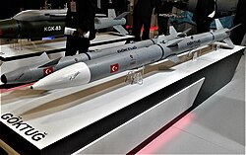
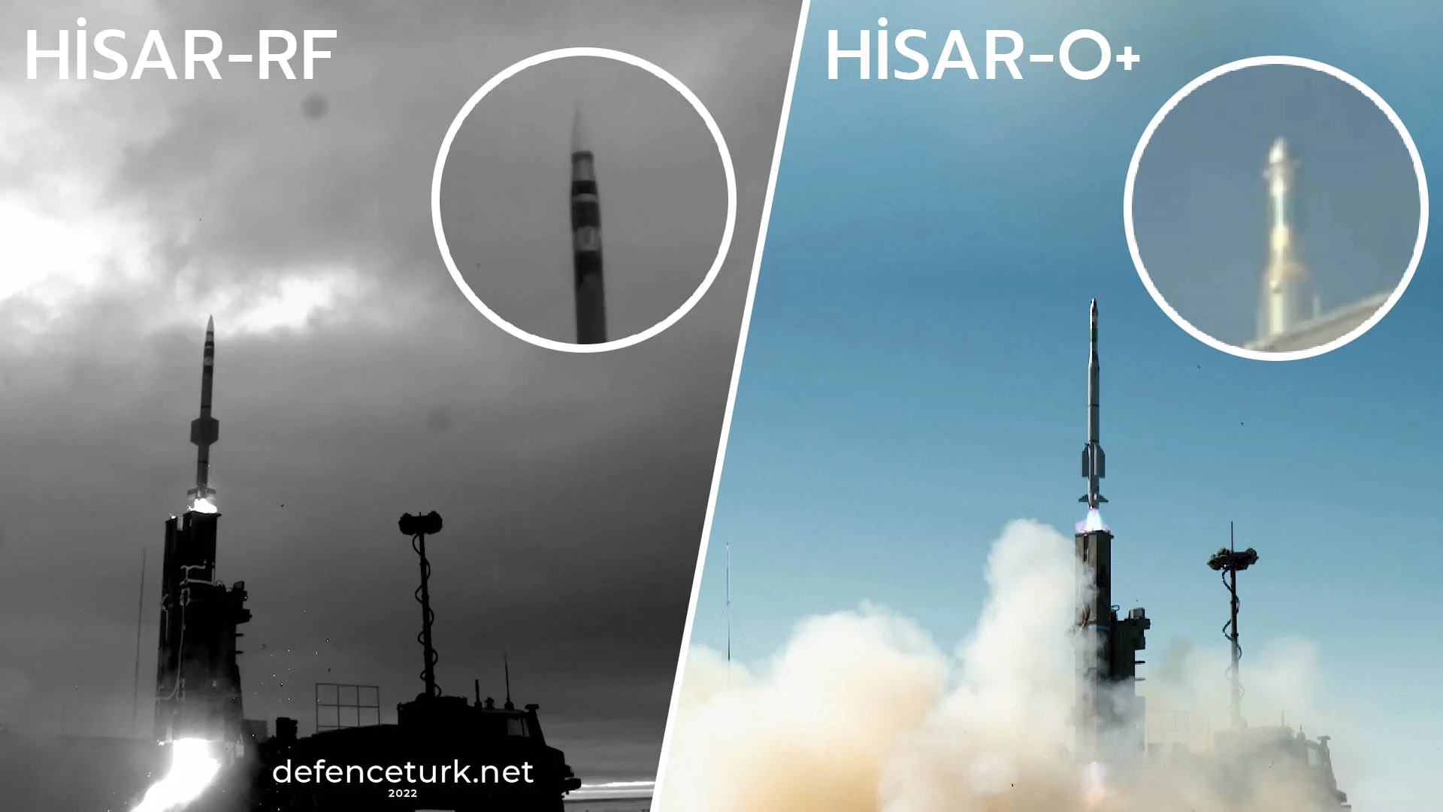
COOPERATIVE OTFS ISAC APPLICATIONS
Active radar homing (ARH) is a missile guidance method in which a missile contains a radar transceiver and the electronics necessary for it to find and track its target autonomously.
      Gokdogan Air-to-air missile
      Hisar-RF Surface-to-air missile
      Hisar-D Surface-to-air missile

Slide 3
OTFS IMPLEMENTATION IN MISSILE LIMITS
Sync is hard: To exploit TDOA/FDOA, you need tight time/freq sync (e.g., <10 ns for ~3 m TDOA granularity). Clock disciplining adds cost/complexity.
Scalability limits: not many missiles are launched together this limits the potencial information gain

Slide 4
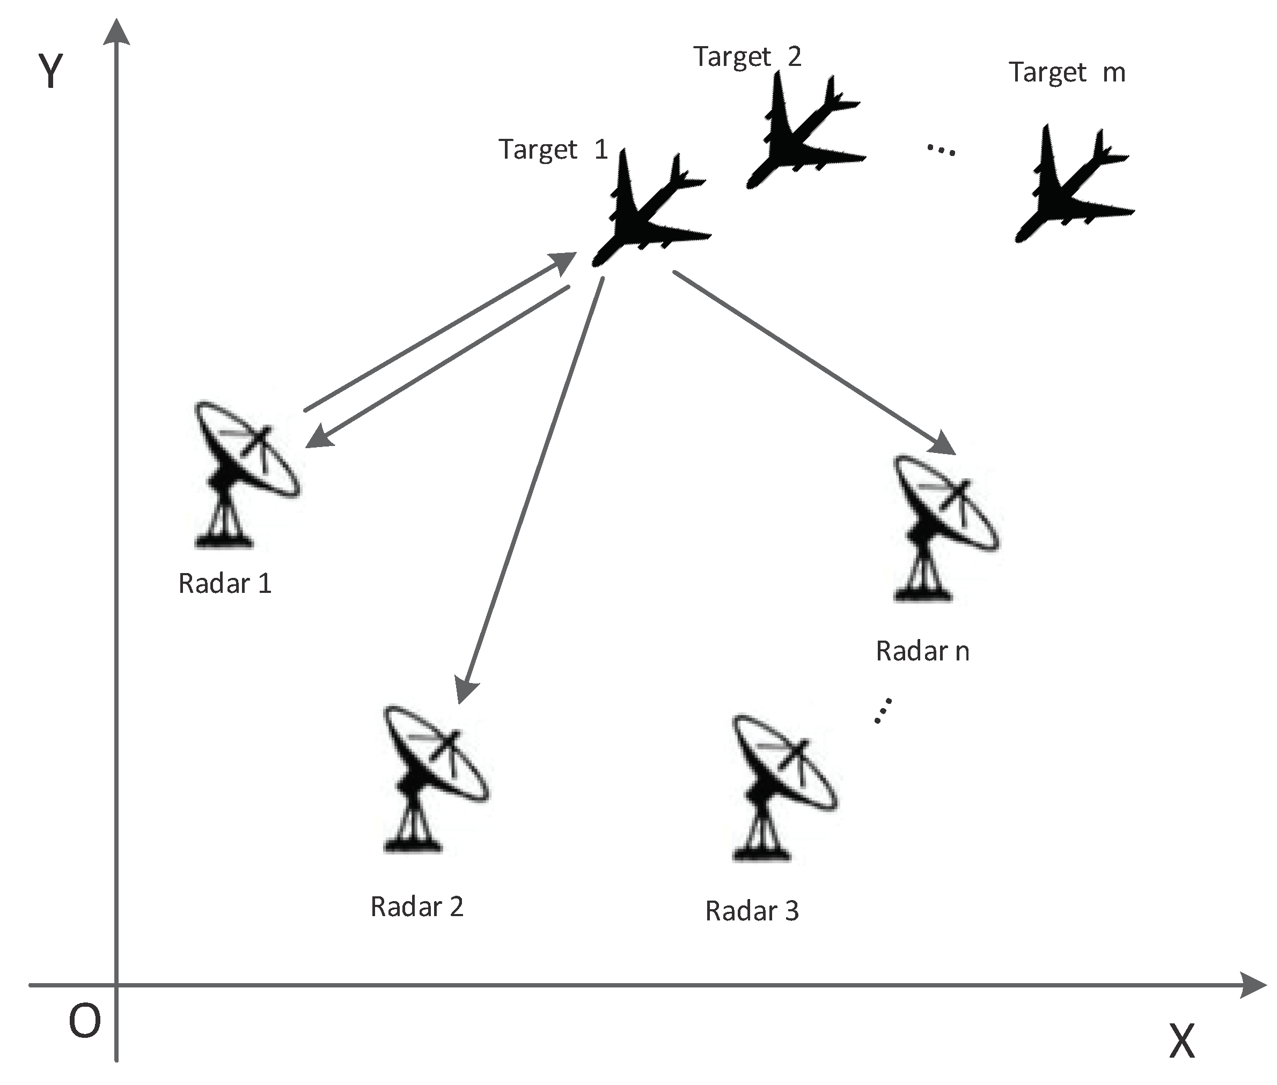
OTFS OTHER APPLICATIONS
This method can be utilized for Radar Networks.
The noise in time tags will be smaller than the time delays between the radars

Slide 5
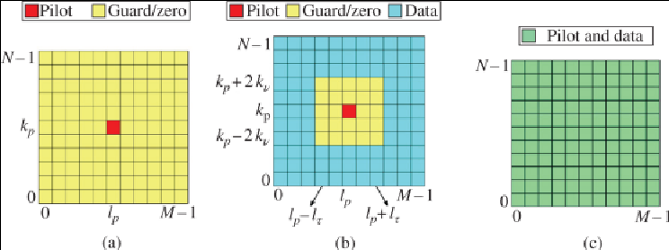
OTFS IMPLEMENTATION
There are 3 main Pilot and data placement approaches for DD channel estimation: (a) exclusive pilot, (b) embedded pilot, and (c)superimposed pilots.
For the sake of this work b is considered.

Slide 6
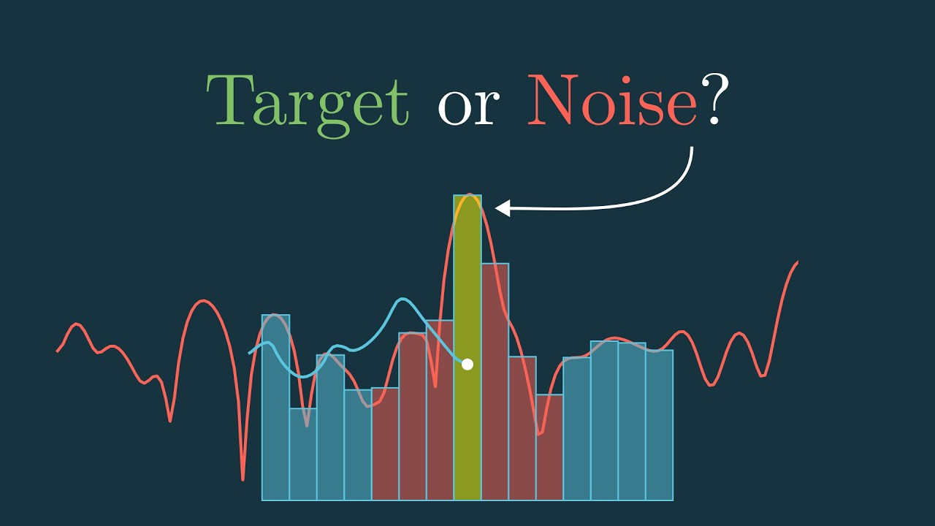
CFAR
After the channel estimation the DD domain estimation must be used for detection.
For detection the 2d CFAR (Constant False Alarm Rate) Algorithm is used

Slide 7
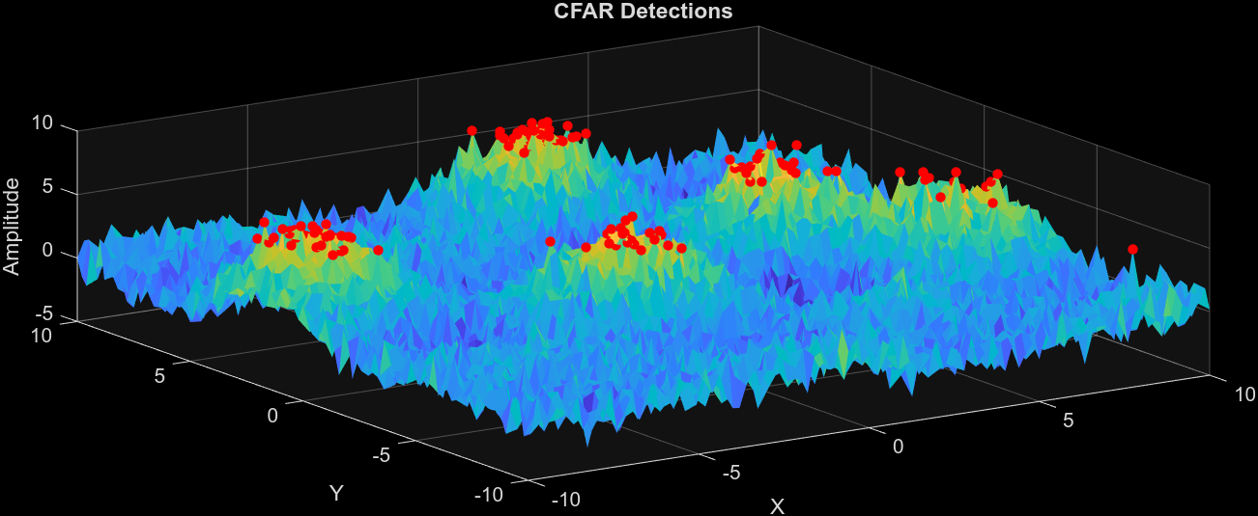
Example CFAR

Slide 8
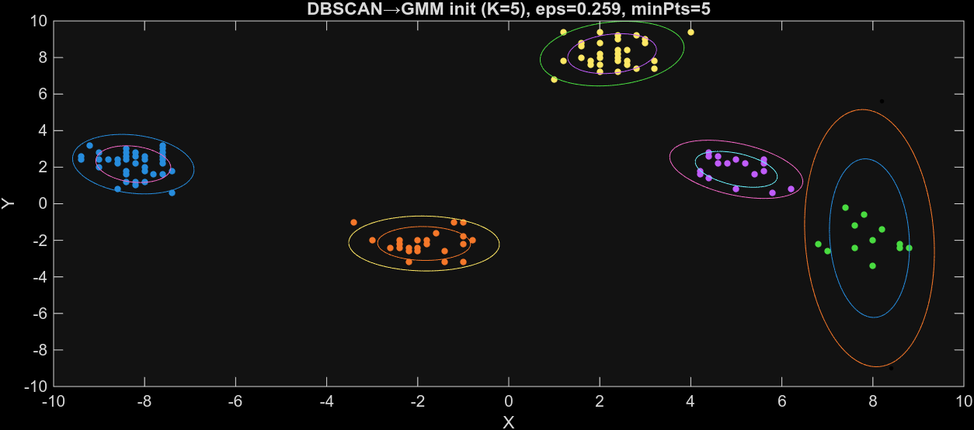
Example CFAR Clustering
Clustering is can be used after CFAR for grouping the detections.
In my work I have used dbscan which is nonparametric and widely used in ASELSAN
This way the outputs can beb fed into a tracker
The second option is to use an extended Object Tracker which fuses these steps.

Slide 9
FUSING ANGLE AND RANGE INFORMATION
A Kalman Filter is used to fuse range and angle information.
EKF is used

Slide 10
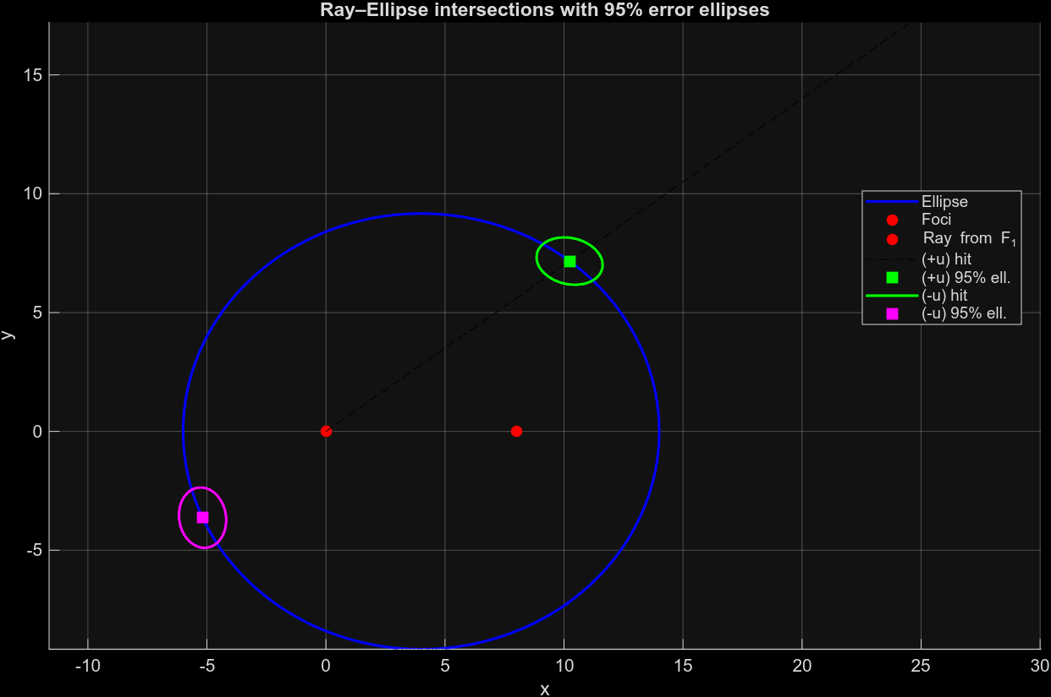
Example Kalman Result

Slide 11
TO DO LIST
Current OTFS implementation only uses the signal from the source platform but not the signals from other platforms.
CFAR Algorithm can be improved.
The implemented codes are not integrated to each other.
The Deep Learning Based Methods are still not implemented.
The tracker algorithms are still not implemented.
Other DD channel estimation can be considered.
I have found a dataset for OTFS signals and contacted to the author.

Slide 12

Q&A

